Slide 1


Coral Gardeners Oral Update
CSE 237D| Marlyn Arque Rupa, Aleksa Popovic, Ewan Shen, Vibusha Vadivel, Kaleigh Edusada

Slide 2

Project Overview
Motivation: Coral health depends on biodiversity
Solution: Detection/Classification of fish species with computer vision
Key Problems:
Poor lighting, camouflage, backscatter, buoys
Domain Shift: Training Data =/= Real Data
Lack of properly labeled datasets
Our Approach:
Notes:
FOR OVERVIEW MENTION WHAT SAM3 IS AND WHAT RF_DETR IS: RF_DETR - transformer-based segmentation model that does great at domain adaptation
SAM3 - Metas AI foundation model designed for detecting, segmenting, and tracking objects in images
BioCLIP is a biology-focused image classification model

Slide 3

Project Objectives
Objectives:
End-to-end pipeline
Evaluation of pipeline
Deliverables:
Python package
Trained detection/classification pipeline
Evaluation results and documentation
Milestones:
Notes:
Objectives:
This quarter our goal is to build an end to end fish segmentation and classification pipeline and evaluate it.
Deliverables:
A fully functional python package, with detection and classification models, and evaluation results on datasets like Deepfish and Moorea datasets, with proper documentation.
Milestones:
¾ finish baseline system, ⅚ finished MVP system ⅞ tackling most pressing key problem which (data pre-procssing alter inputs) , last finalizing the system and writing documentation.
Overall Project: how this fits into the overall project is that
Together, with these milestones will support on creating a reliable system that would segment and classify fish.

Slide 4
MVP
Accomplishments:
MVP goals:
A working Python package that can segment fish in reef images ✅
A working classifier that can be changed for a specific location ✅
Initial evaluation on given dataset or similar reef imagery ✅
Identified failures
Improved pipeline performance
Evaluated 5 different models
Notes:
Failures - not accurately labeled dataset, domain shift
Improved performance by using AI models and pipeline adaptation, model comparison, threshold tuning, data preprocessing

Slide 5
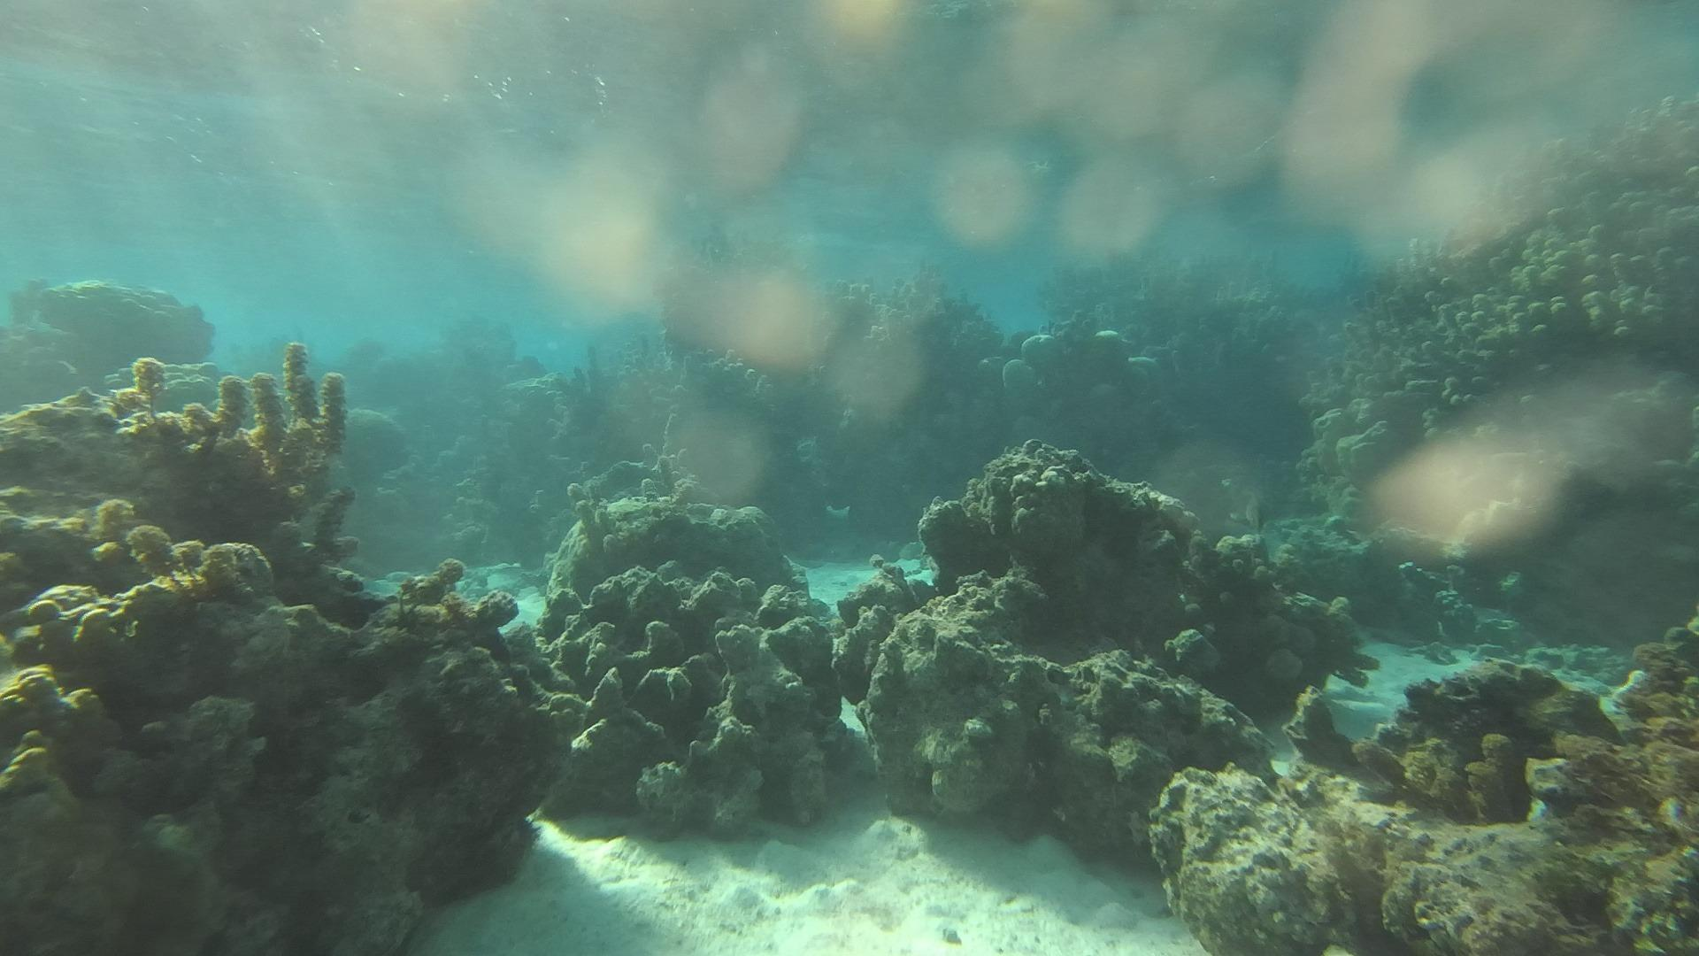
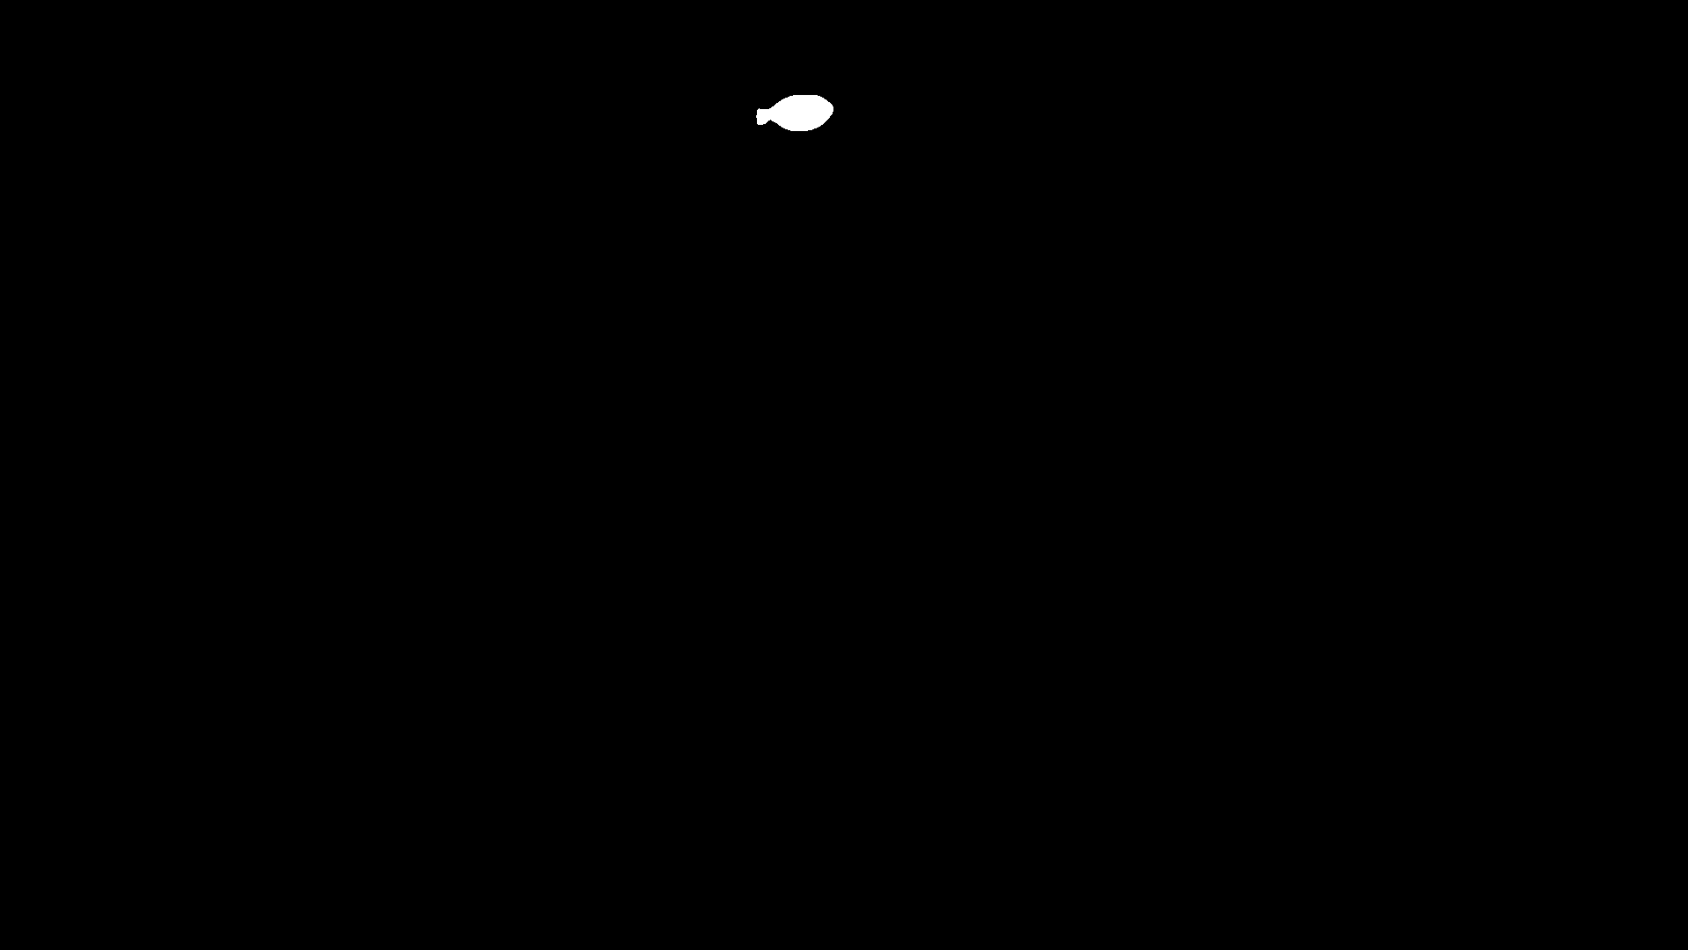

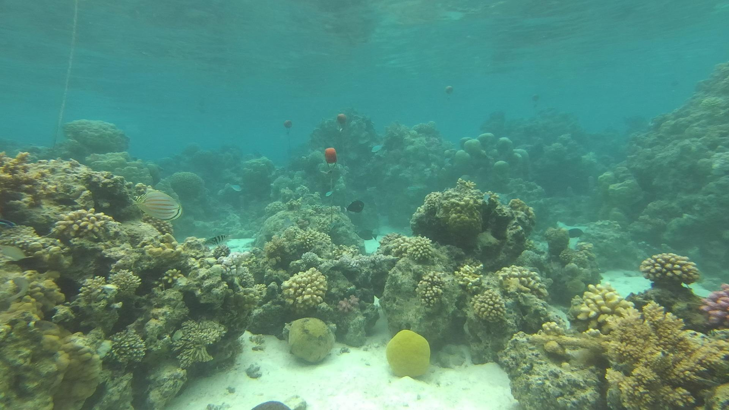

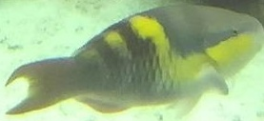

MVP - Data Segmentation
Input Images:
Mask Examples (for SAM3):
Model segmentation:
Notes:
This is an example image from the dataset provided to us by coral gardeners.
Most of them are mislabeled and fish species are either named ‘fish’ or one of 4 species that they had.
This resulted in our exploration of online labeled datasets that we would use for training as well as testing
real-time transformer-based model for object detection and instance segmentation

Slide 6
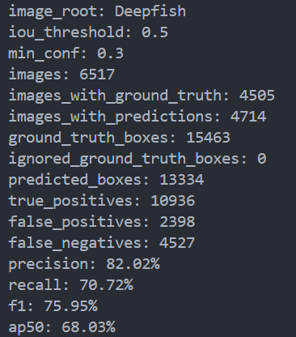
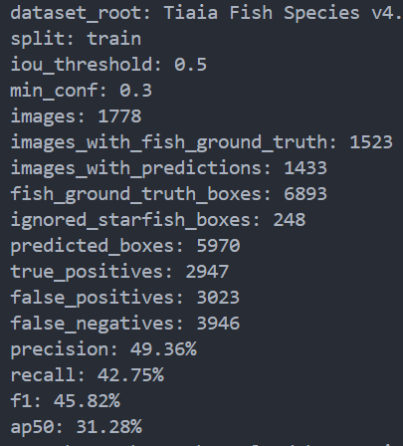
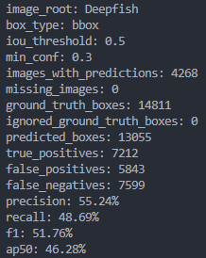
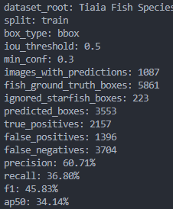
MVP - Stats for Segmentation
Deepfish Kaggle Dataset (SAM3)
Coral Gardeners Dataset (SAM3)
Deepfish Kaggle Dataset (RF_DETR)
Coral Gardeners Dataset (RF_DETR)

Slide 7
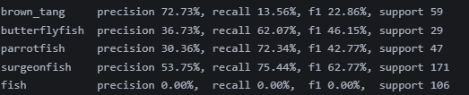
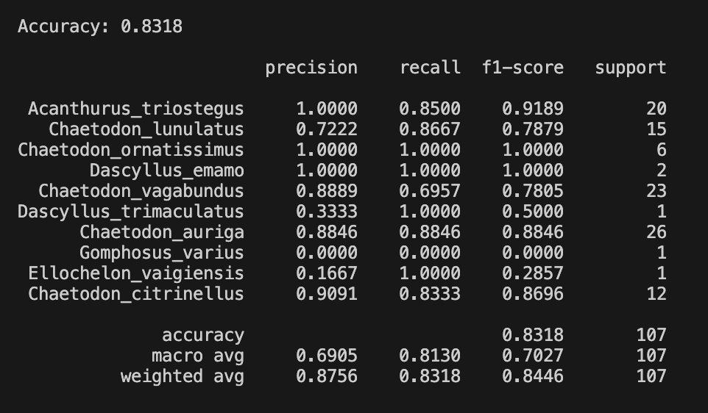
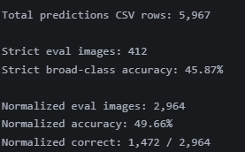
MVP - Classification BioCLIP
BioCLIP - Image -> species labels to predict match
Coral Gardeners Data Set
iNaturalist Data Set
real world images for classification with specific scientific labels
Notes:
After segmenting the fish images, we compare each image to our target classes, such as butterflyfish or surgeonfish, and BioCLIP then classifies it the closest match. With BioCLIP, from our MVP, it can identify fish based on specific locations.
inaturalist is a real world image dataset of fish from different locations. We focused on the top 15 fish species from Moorea because that matches Mr.Williams working environment the most.
We use BioClip on both Coral Gardeners and iNaturalist. The Coral Gardeners dataset had lower accuracy, around 49.66%. This likely happened because there is a broad label of just “fish” with more specific groups like “parrotfish” and “surgeonfish.” In comparison, iNaturalist performed much better, with approximately 83% accuracy, because its labels are cleaner and more species-specific.

Slide 8
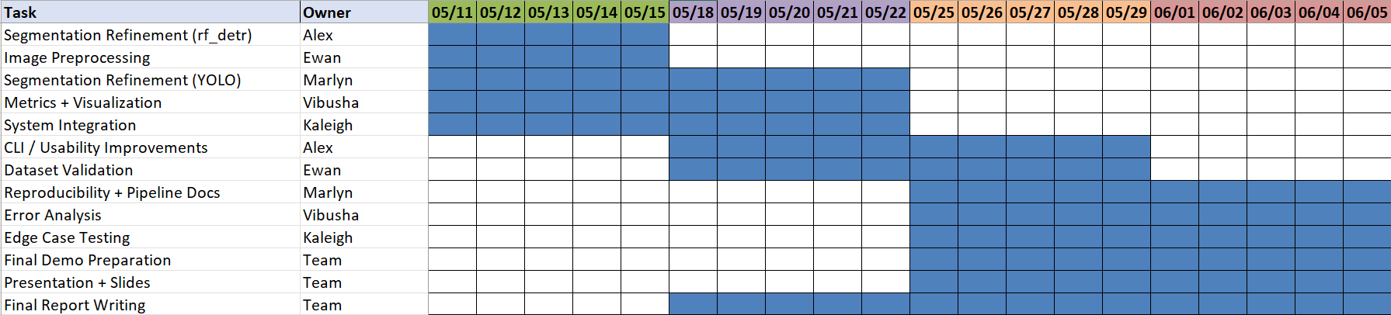
Quarter Plan
Remaining Milestones in the Gantt chart form:
Notes:
This slide shows our plan for the rest of the quarter. We split the work into three main phases. First, we focus on improving the technical pipeline, including segmentation refinement, image preprocessing, metrics, and system integration. Then, we move into validation and usability work, such as dataset validation, command line interface improvements, error analysis, and edge case testing. Finally, the last phase is focused on wrapping up the project with reproducibility documentation, final demo preparation, presentation slides, and the final report. Overall, the goal is to make sure the model is not only working, but also tested, documented, and ready to present by the end of the quarter.”

Slide 9
Conclusion
Progress Summary:
Built end-to-end pipeline
Identified major failure points
Improved performance through model choice
Key Problems:
Domain shift and low resolution data
Future Plans:
Image preprocessing
Compare rf_detr, SAM3, combined approach for segmentation
Notes:
reducing domain-shift problems so the package works reliably on real Coral Gardeners imagery.

